Slide 1
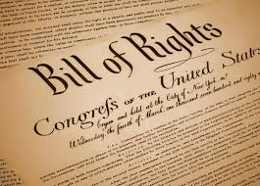
The Bill of Rights
The first 10 amendments to the Constitution
Addressing individual freedoms of all Americans.

Slide 2
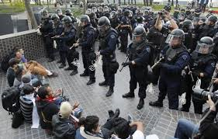
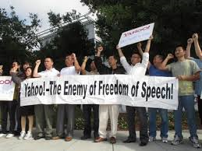
Amendment 1—Freedom of Speech, Press, Assembly, Religion
Congress shall make no law respecting an establishment of religion, or prohibiting the free exercise thereof; or abridging the freedom of speech, or of the press; or the right of the people peaceably to assemble, and to petition the government for a redress of grievances.
The First Amendment guarantees freedoms concerning religion, expression, assembly, and the right to petition. It forbids Congress from both promoting one religion over others and also restricting an individual’s religious practices. It guarantees freedom of expression by prohibiting Congress from restricting the press or the rights of individuals to speak freely. It also guarantees the right of citizens to assemble peaceably and to petition their government.

Slide 3
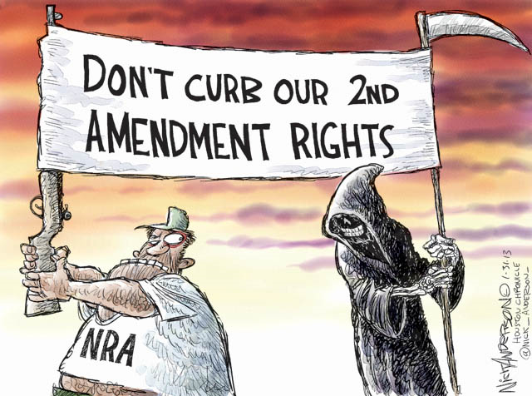
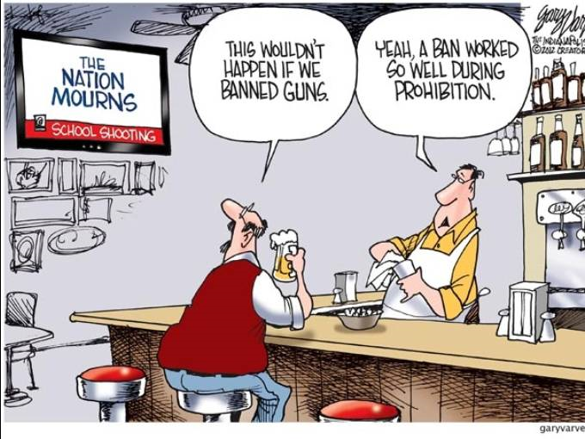
Amendment II- -The Right to Bear Arms
A well regulated militia, being necessary to the security of a free state, the right of the people to keep and bear arms, shall not be infringed.
This amendment is often debated. Some argue it protects the rights of the
States to have militias. Others argue that the Founder’s original intent was to protect the right of individuals to have weapons.

Slide 4
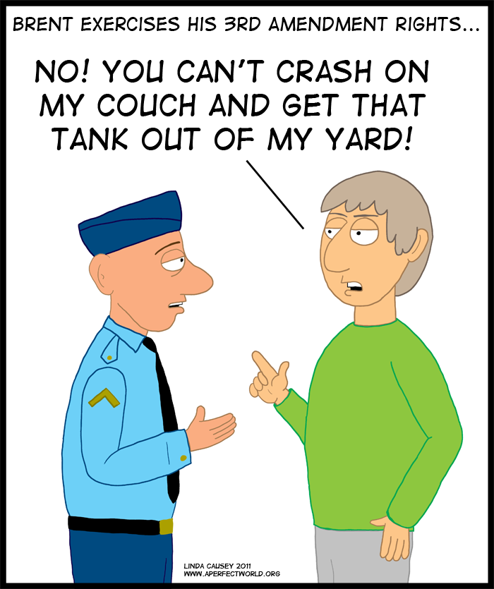
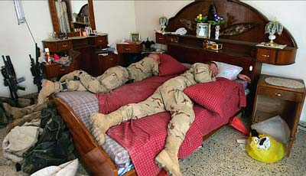
Amendment III- -The Quartering of Soldiers
No soldier shall, in time of peace be quartered in any house, without the consent of the owner, nor in time of war, but in a manner to be prescribed by law.
The 3rd Amendment guarantees that the army cannot force homeowners house and feed soldiers.

Slide 5
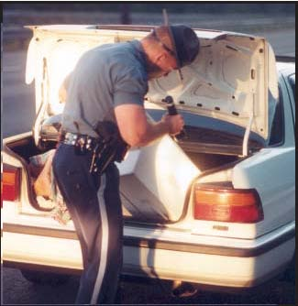
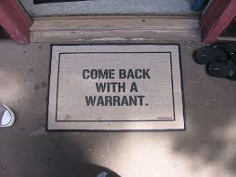
Amendment IV.- - Right of search and seizure regulated
The right of the people to be secure in their persons, houses, papers, and effects, against unreasonable searches and seizures, shall not be violated, and no warrants shall issue, but upon probable cause, supported by oath or affirmation, and particularly describing the place to be searched, and the persons or things to be seized.
The 4th Amendment protects the people from the government improperly taking property, papers, or people, without a valid warrant based on probable cause (good reason).

Slide 6
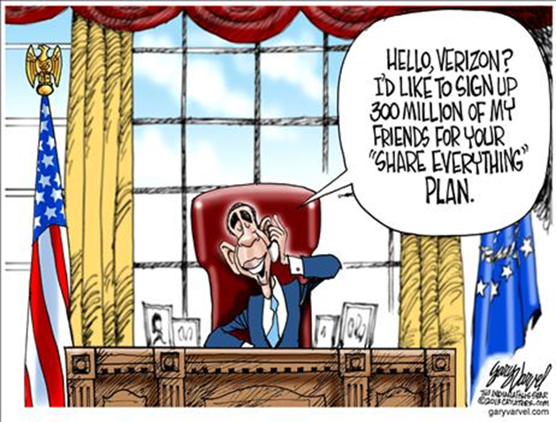

Slide 7
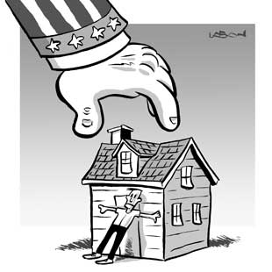
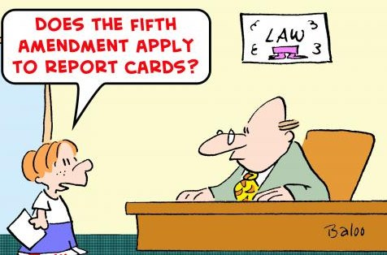
Amendment V.- -Provisons concerning prosecution
No person shall be held to answer for a capital, or otherwise infamous crime, unless on a presentment or indictment of a Grand Jury, except in cases arising in the land or naval forces, or in the militia, when in actual service in time of war or public danger; nor shall any person be subject for the same offense to be twice put in jeopardy of life or limb; nor shall be compelled in any criminal case to be a witness against himself, nor be deprived of life, liberty, or property, without due process of law; nor shall private property be taken for public use without just compensation.
The 5th Amendment protects people from being held for committing a crime unless they are properly accused of a crime, that they may not be tried twice for the same crime (double jeopardy), that you need not be forced to testify against yourself, and from property being taken without just compensation (eminent domain)

Slide 8
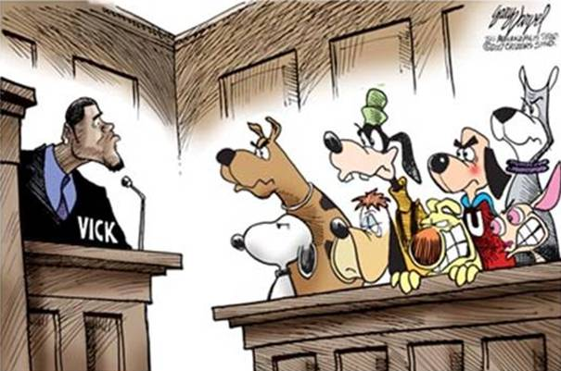
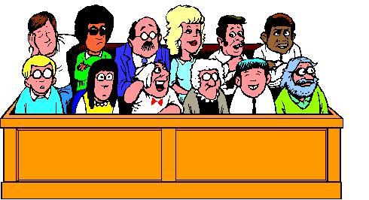
Amendment VI.- -Right to a speedy trial, witnesses, etc.
In all criminal prosecutions, the accused shall enjoy the right to a speedy and public trial, by an impartial jury of the State and district wherein the crime shall have been committed, which district shall have been previously ascertained by law, and to be informed of the nature and cause of the accusation; to be confronted with the witnesses against him; to have compulsory process for obtaining witnesses in his favor, and to have the assistance of counsel for his defense.
The 6th Amendment guarantees a speedy trial, a jury that doesn’t already think you are guilty, accused people can confront witnesses against them, and that the accused must be allowed to have a lawyer.

Slide 9
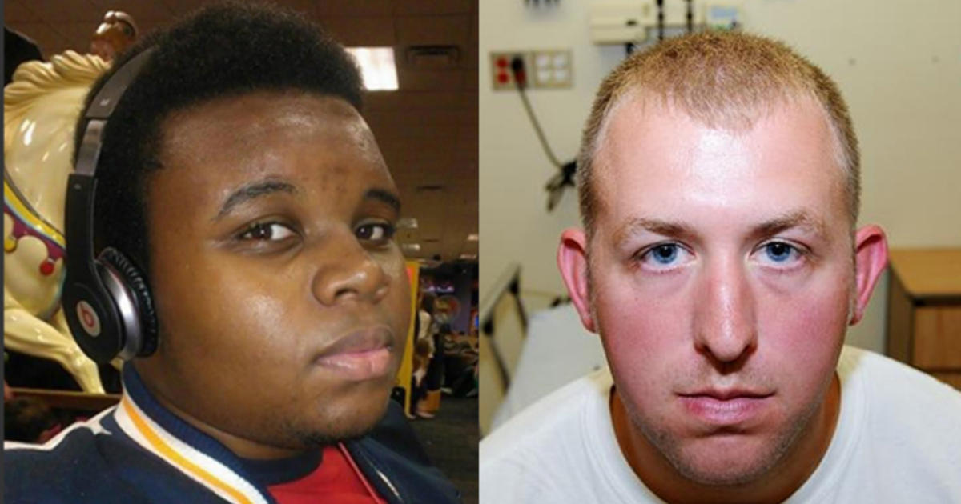
Amendment VII.- -Right to a Trial by Jury
In suits at common law, where the value in controversy shall exceed twenty dollars, the right of trial by jury shall be preserved, and no fact tried by a jury shall be otherwise reexamined in any court of the United States, than according to the rules of the common law.
The 7th Amendment guarantees a jury trial in federal civil court cases. This type of case is normally no longer heard in federal court. The amount was changed to
$75,000.

Slide 10
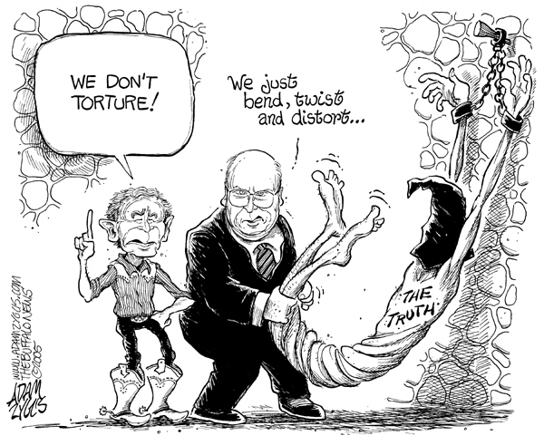
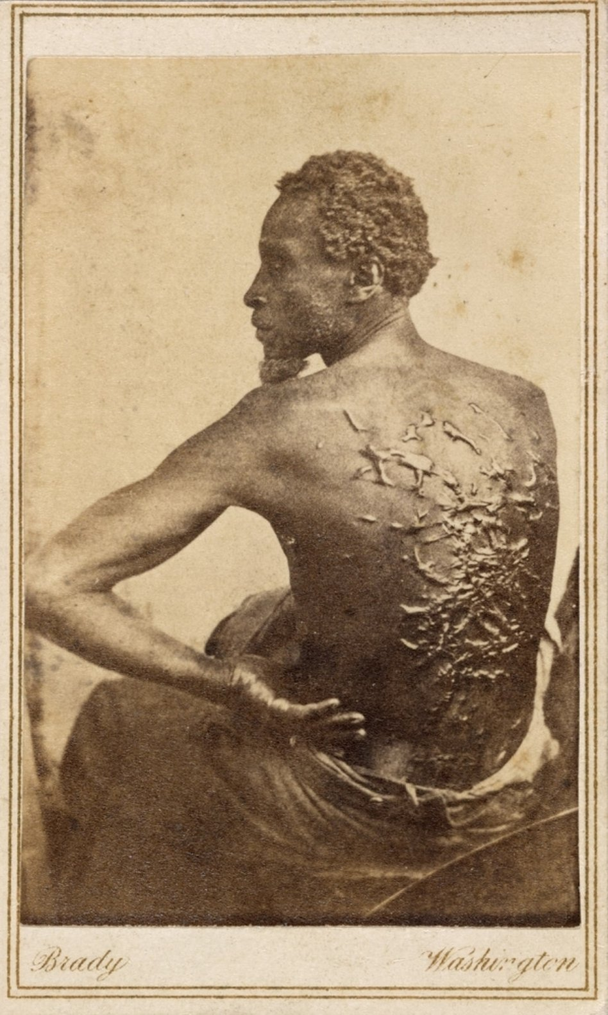
Amendment VIII. - -Excessive Bail, Cruel Punishment
Excessive bail shall not be required, nor excessive fines imposed, nor cruel and unusual punishments inflicted.
The 8th Amendment guarantees that punishments will be fair, and not cruel, and that extraordinarily large fines will not be set.

Slide 11
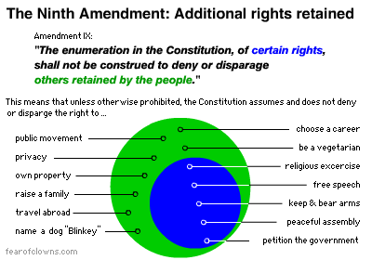
Amendment IX- - Rule of construction of Constitution
The enumeration in the Constitution, of certain rights, shall not be construed to deny or disparage others retained by the people.
The 9th Amendment is simply a statement that other rights aside from those listed may exist, and just because they are not listed doesn't mean they can be violated.

Slide 12
Amendment X.- -Rights of the States under Constitution
The powers not delegated to the United States by the Constitution, nor prohibited by it to the States, are reserved to the States respectively, or to the people.
The 10th Amendment states that any power not granted to the federal government belongs to the states or to the people.

